Slide 1
Title: Improving Healthcare Access and Disease Management in Rural Areas
Subtitle: A Data-Driven Solution for SDG 3: Good Health and Well-being
Presented by: Rosemary Nduati
Date: 29th January 2025

Slide 2
SDG 3: Good Health and Well-being
SDG 3 aims to ensure healthy lives and promote well-being for all people, at all ages.
Key Targets:
Reduce maternal mortality.
End preventable deaths of newborns and children under 5.
Combat communicable diseases.
Universal health coverage and access to healthcare.

Slide 3
Problem: Healthcare Inequality in Rural Areas
Issue: Lack of access to healthcare in rural regions leads to higher mortality rates from preventable diseases.
Focus: Disease management for preventable diseases such as malaria, hypertension, and maternal health complications.
Impact: Increased healthcare disparities and delayed treatment resulting in poorer health outcomes.

Slide 4
A Data-Driven Solution to Improve Healthcare Access
Goal: Use data to track healthcare access, disease prevalence, and resource distribution in rural areas.
Method: Build a relational database to capture healthcare visits, facility resources, and patient data.
Outcome: Analyze the data to provide actionable insights that inform resource allocation and policy decisions.

Slide 5
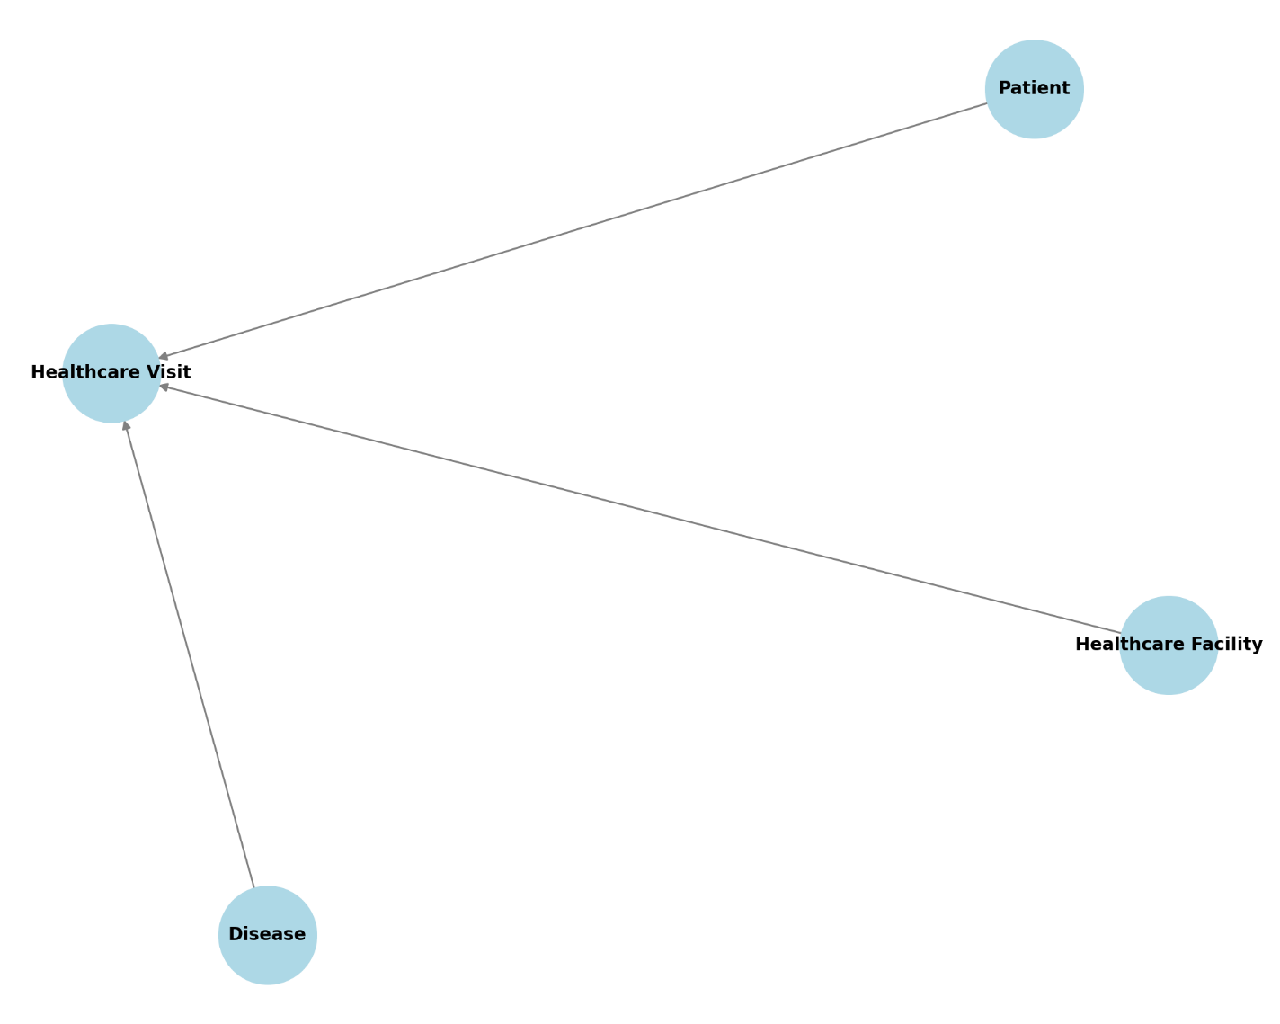
Database Design: Entity-Relationship Diagram (ERD)

Slide 6
Entities (Nodes):
Patient: Represents individuals receiving healthcare services. Each patient can have multiple healthcare visits.
Healthcare Facility: Represents medical institutions such as hospitals, clinics, or health centers where patients receive care.
Disease: Represents the various diseases or health conditions that are treated in healthcare facilities. Each healthcare visit can be associated with one or more diseases.
Healthcare Visit: Represents the act of a patient visiting a healthcare facility. This is a central entity that connects the patient, healthcare facility, and disease.

Slide 7
Relationships (Edges):
Patient - Healthcare Visit (Undergoes): This relationship indicates that a patient undergoes one or more healthcare visits. Each visit is linked to a specific patient.
Healthcare Facility - Healthcare Visit (Hosts): This relationship shows that a healthcare facility hosts multiple healthcare visits. Each visit occurs at a particular healthcare facility.
Disease - Healthcare Visit (Related to): This relationship links diseases to healthcare visits, indicating that each visit may be related to one or more diseases being treated or diagnosed.

Slide 8
SQL Queries for Data Retrieval and Insights
Key SQL Queries:
Retrieve total healthcare visits by region.
Identify the most prevalent diseases in rural areas.
Track healthcare visits by healthcare facility.
Purpose: These queries help extract relevant data to analyze healthcare access, disease management, and resource distribution.

Slide 9
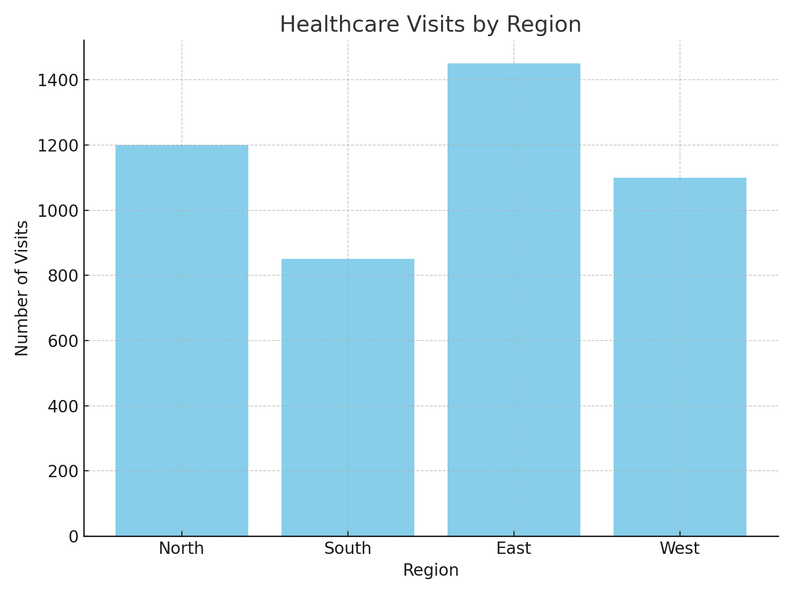
Key Insights from Data Analysis

Slide 10
Healthcare Visits by Region: Highlight which regions have the highest healthcare visits and potential resource shortages.
Disease Distribution: Show which diseases are most prevalent in rural areas.
Healthcare Facility Performance: Identify healthcare facilities with the most visits and the need for additional resources.

Slide 11
Interactive Excel Dashboard
Features:
Pivot tables and charts for healthcare visits, disease prevalence, and facility performance.
Slicers for filtering data by region, disease type, etc.
Dynamic charts for real-time insights.

Slide 12
Proposed Solutions and Recommendations
Resource Allocation: Use insights from the analysis to allocate more healthcare resources to regions with the highest demand.
Disease Management: Target preventable diseases based on prevalence data, and allocate more healthcare professionals to high-need areas.
Policy Support: Provide actionable data-driven recommendations to policymakers to improve healthcare access in rural areas.

Slide 13
Conclusion and Next Steps
Conclusion: By addressing healthcare access inequalities and leveraging data, we can improve disease management and health outcomes in rural areas.
Next Steps:
Implement resource allocation strategies based on the analysis.
Expand the data system to include more regions and diseases.
Work with policymakers to enact changes that improve healthcare access.
Call to Action: Encourage stakeholders to use data for informed decision-making to drive positive health outcomes.

